Slide 1
Investing 101
Erick Mokaya

Slide 2
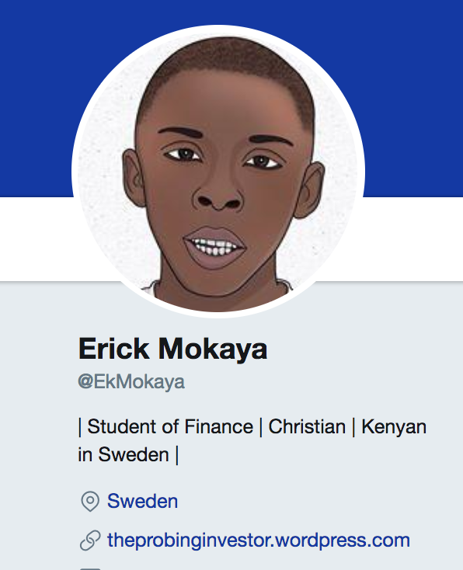
About me

Slide 3
Outline
What?
Why and When?
Where and how?
What can we learn from the best?
Conclusion

Slide 4
What Is Investing?

Slide 5
Investment vs Speculation
"An investment operation is one which, upon thorough analysis, promises safety of principal and an adequate return. Operations not meeting these requirements are speculative.”
-Benjamin Graham-

Slide 6
Why should we Invest?
Safety of principal
Adequate Return
Impact

Slide 7
When should we invest?
The time is now

Slide 8
The power of compounding
$15,848
Source: Business Finance

Slide 9
The power of compounding
“If you started investing at age 25 and put the same amount of money into stocks until age 35, you’d have more money at retirement than if you started saving at 35 and invested the same amount of money in stocks EVERY YEAR until retirement”
$15,848
Source: Darwins Finance

Slide 10
Where do you invest?
Traditional
Newer
Stocks
Bonds
Commodities
Alternative investments
Derivatives
Crypto-currencies

Slide 11
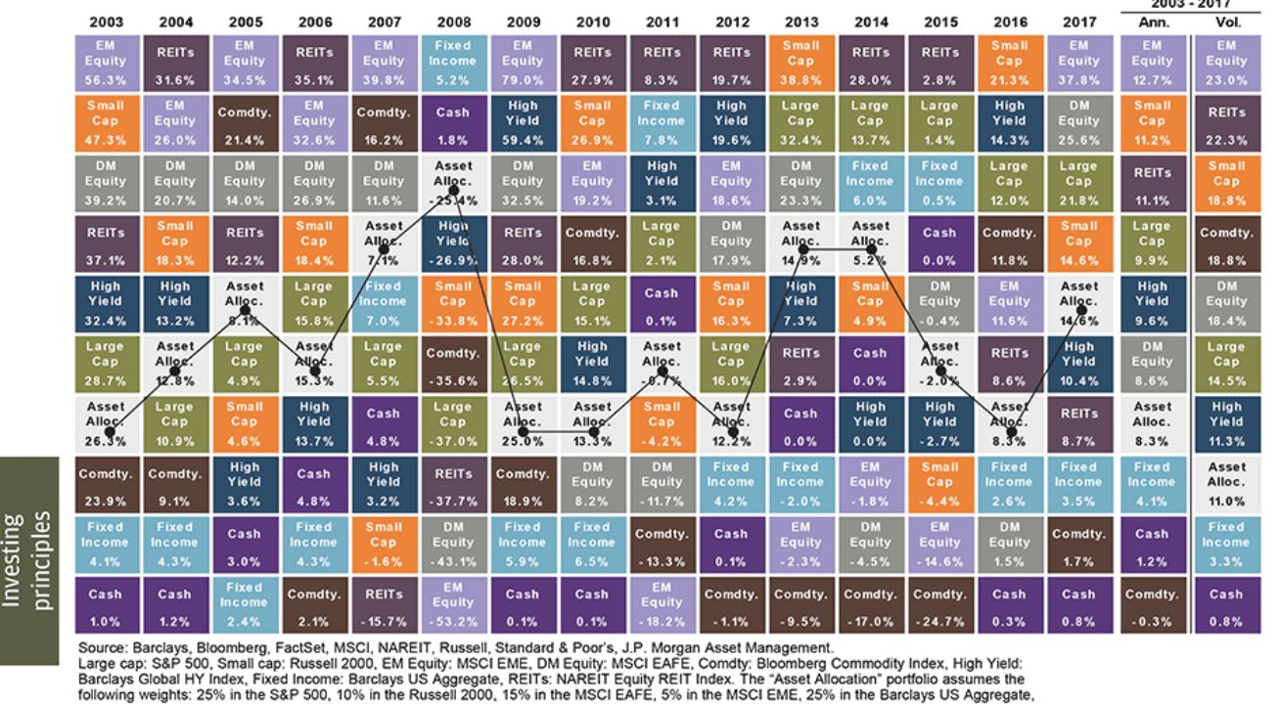
There is a lot to invest in

Slide 12
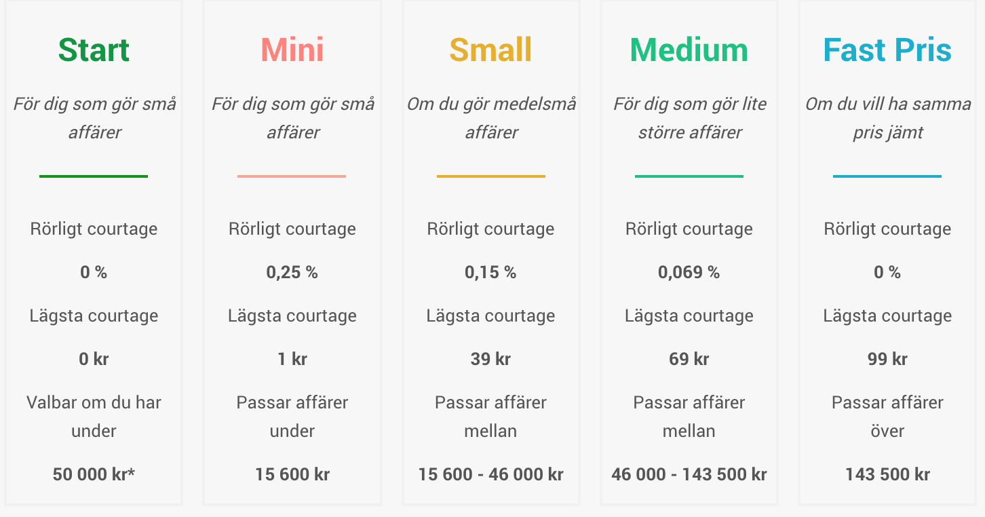

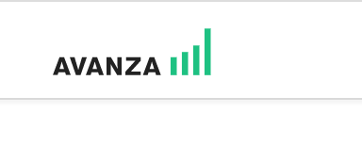
How?
Nordnet

Slide 13
Learn from the best

Slide 14
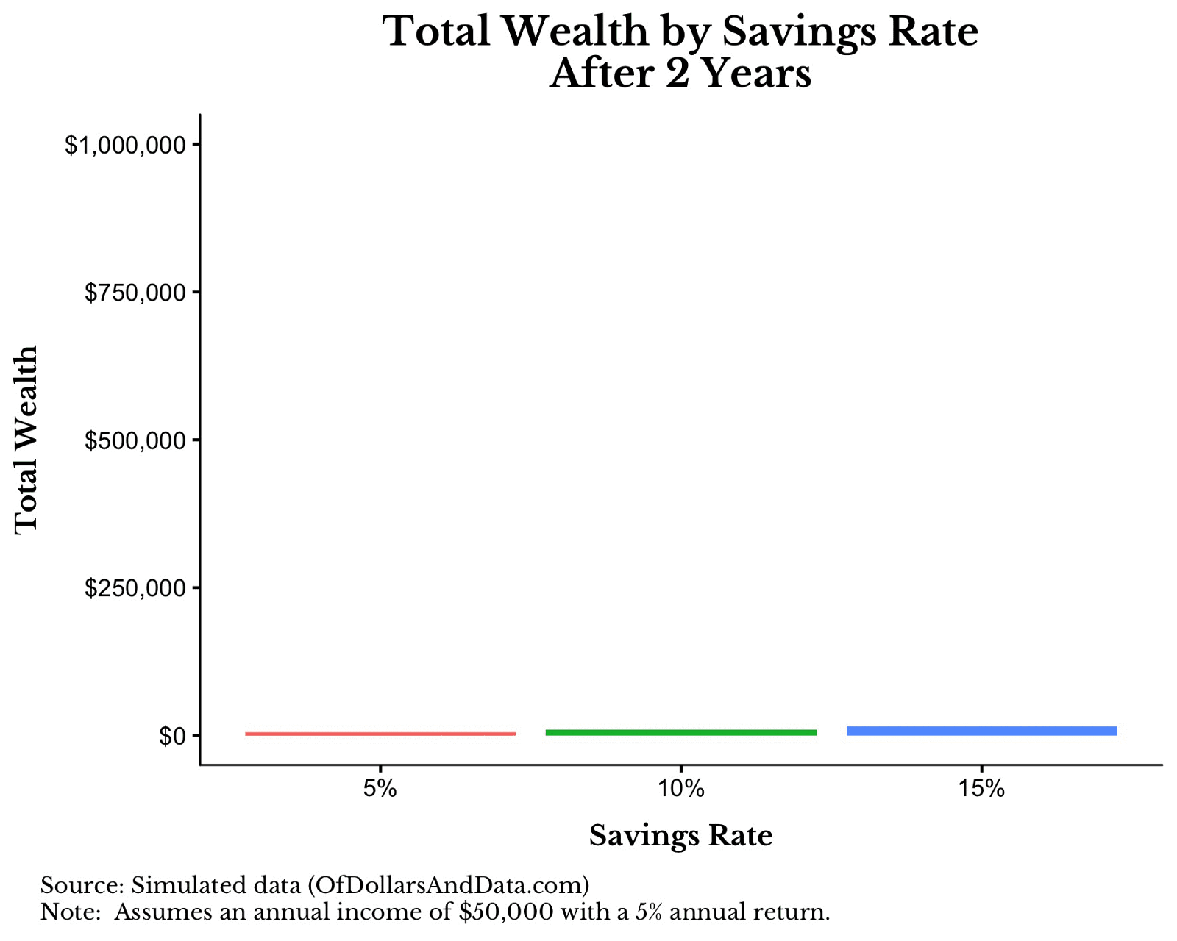
Saving rates make a difference

Slide 15
Read, read read.
“I don’t think you can get to be a really good investor over a broad range without doing a massive amount of reading. I don’t think any one book will do it for you.”
"I read more than three hours almost every day,"
"This year I read 82 books, down from 103 last year." (2016)

Slide 16
Recommended materials
Podcast: Invest like the best, Masters in Business, Animal Spirits,
Books: The Little Book of Common Sense Investing, The Intelligent Investor, Dream Big, Security Analysis
Blogs: Of Dollars and Data, A wealth of common sense, Abnormal Returns, The Reformed Broker, Farnam Street, Collaborative Fund, Adventur.es,
People to follow on Twitter: Morgan Housel, Patrick O'shaughnessy, Barry Ritholtz and the Ritholtz Crew, Brenth Beshore, Noah Smith, Jason Zweig

